Slide 1
“THEORY OF AUTOMATA”
Nonregular languages

Slide 2
Summary
Context Free Grammar, Terminals, non-terminals, productions, CFG, context Free language, examples.
Context Free Grammar (CFG)
The earliest computers accepted no instructions other then their own assembly language. Every procedure, no matter how complicated , had to be encoded in the set of instructions, LOAD, STORE, ADD the contents of two registers and so on.

Slide 3

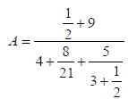
The major problem was to display mathematical formulas as follows
or

Slide 4
So, it was necessary to develop a way of writing such expressions in one line of standard typewriter symbols, so that in this way a high level language could be invented. Before the invention of computers, no one would ever have dreamed of writing such complicated formula in parentheses e.g. the right side of formula can be written as
((1/2)+9)/(4+(8/21)+(5/(3+(1/2))))
The high level language is converted into assembly language codes by a program called compiler.
The compiler that takes the user’s programs as its inputs and prints out an equivalent program written in assembly language.

Slide 5
Like spoken languages, high level languages for computer have also, certain grammar. But in case of computers, the grammatical rules, don’t involve the meaning of the words.
It can be noted that the grammatical rules which involve the meaning of words are called Semantics, while those don’t involve the meaning of the words are called Syntactics.
e.g. in English language, it can not be written “ Buildings sing ”, while in computer language one number is as good as another.
e.g. X = B + 10, X = B + 999

Slide 6

CFG terminologies
Terminals: The symbols that can’t be replaced by anything are called terminals.
Non-Terminals: The symbols that must be replaced by other things are called non-terminals.
Productions: The grammatical rules are often called productions.
CFG
CFG is a collection of the followings
An alphabet S of letters called terminals from which the strings are formed, that will be the words of the language.
A set of symbols called non-terminals, one of which is S, stands for “start here”.
A finite set of productions of the form non-terminal A finite string of terminals and /or non-terminals.

Slide 7
Context Free Language (CFL)
The language generated by CFG is called Context Free Language (CFL).
Example
S = {a}
productions:
S aS
S Λ

Slide 8
Applying production (1) six times and then production (2) once, the word aaaaaa is generated as
S aS
aaS
aaaS
aaaaS
aaaaaS
aaaaaaS
aaaaaaΛ
= aaaaaa

Slide 9
It can be observed that prod (2) generates L, a can be generated applying prod. (1) once and then prod. (2), aa can be generated applying prod. (1) twice and then prod. (2) and so on. This shows that the grammar defines the language expressed by a*.
Example
∑ = {a}
productions:
S SS
S a
S Λ
This grammar also defines the language expressed by a*.

Slide 10
Example
∑ = {a,b}
productions:
S X
S Y
X Λ
Y aY
Y bY
Y a
Y b
All words of this language are of either X-type or of Y-type. i.e. while generating a word the first production used is S X or
S Y. The words of X-type give only Λ, while the words of Y-type are words of finite strings of a’s or b’s or both i.e. (a+b)+. Thus the language defined is expressed by (a+b)*.

Slide 11
Example
∑ = {a,b}
productions:
S aS
S bS
S a
S b
S Λ
This grammar also defines the language expressed by (a+b)*.

Slide 12
Example
S = {a,b}
productions:
S XaaX
X aX
X bX
X Λ
This grammar defines the language expressed by (a+b)*aa(a+b)*.

Slide 13
Continuous
Examples of CFL, EVEN-EVEN, EQUAL, Language of strings containing bbb, PALINDROME, {a^{n}b^{n}}, Language of strings beginning and ending in different letters, Parsing tree, example
Example
∑ = {a,b}
productions:
S SS
S XS
S Λ
S YSY
X aa
X bb
Y ab
Y ba
This grammar generates EVEN-EVEN language.

Slide 14
Example
∑ = {a,b}
productions:
S aB
S bA
A a
A aS
A bAA
B b
B bS
B aBB
This grammar generates the language EQUAL(The language of strings, with number of a’s equal to number of b’s).

Slide 15
Example
∑ = {a,b}
productions:
S YXY
Y aY|bY|Λ
X bbb
It can be observed that, using prod.2, Y generates Λ. Y generates a. Y generates b. Y also generates all the combinations of a and b. thus Y generates the strings generated by (a+b). It may also be observed that the above.

Slide 16
CFG generates the language expressed by (a+b)*bbb(a+b)*. Following are four words generated by the given CFG
S YXY
aYbbbΛ
abYbbb
abΛbbb
= abbbb
S YXY
  bYbbbaY
bΛbbbabY
  bbbbabbY
bbbbabbaY
bbbbabbaΛ
= bbbbabba
S YXY
ΛbbbaY
bbbabY
bbbabaY
bbbabaΛ
= bbbaba
S YXY
bYbbbaY
bΛbbbaΛ
= bbbba

Slide 17
Example
Consider the following CFG
S S|XaXaX|Λ
X bX|Λ
It can be observed that, using prod.2, X generates Λ. X generates any number of b’s. Thus X generates the strings generated by b*. It may also be observed that the above CFG generates the language expressed by (b*ab*ab*)*.

Slide 18
Example
Consider the following CFG
∑= {a,b}
productions:
S aSa|bSb|a|b|Λ
The above CFG generates the language PALINDROME. It may be noted that the CFG S aSa|bSb|a|b generates the language NON-NULLPALINDROME.

Slide 19
Example
Consider the following CFG
∑ = {a,b}
productions:
S aSb|ab|Λ
It can be observed that the CFG generates the language {a^{n}b^{n}: n = 0,1,2,3, …}. It may also be noted that the language {a^{n}b^{n}: n=1,2,3, …} can be generated by the CFG, S aSb|ab

Slide 20
Example
Consider the following CFG
S aXb|bXa
X aX|bX|Λ
The above CFG generates the language of strings, defined over ∑={a,b}, beginning and ending in different letters.

Slide 21

Trees
As in English language any sentence can be expressed by parse tree, so any word generated by the given CFG can also be expressed by the parse tree, e.g. consider the following CFG
S AA
A AAA|bA|Ab|a
Obviously, baab can be generated by the above CFG. To express the word baab as a parse tree, start with S.
Replace S by the string AA, of nonterminals, drawing the downward lines from S to each character of this string as follows

Slide 22

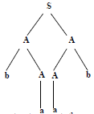
Now let the left A be replaced by bA and the right one by Ab then the tree will be
Replacing both A’s by a, the above tree will be
Thus the word baab is generated. The above tree to generate the word baab is called Syntax tree or Generation tree or Derivation tree as well.

Slide 23
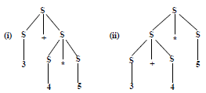
Example of trees, Polish Notation, examples, Ambiguous CFG
Example
Consider the following CFG
S S+S|S*S|number
where S and number are non-terminals and the operators behave like terminals.
The above CFG creates ambiguity as the expression 3+4*5 has two possibilities (3+4)*5=35 and 3+(4*5)=23 which can be expressed by the following production trees

Slide 24
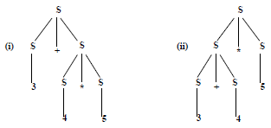
Polish Notation (o-o-o)
There is another notation for arithmetic expressions for the CFG,
S S+S|S*S|number. Consider the following derivation trees

Slide 25
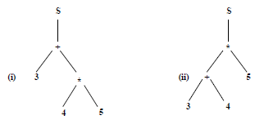
The arithmetic expressions shown by the trees (i) and (ii) can be calculated from the following trees, respectively

Slide 26
Here most of the S’s are eliminated.
The branches are connected directly with the operators. Moreover, the operators + and * are no longer terminals as these are to be replaced by numbers (results).
To write the arithmetic expression, it is required to traverse from the left side of S and going onward around the tree. The arithmetic expressions will be as under
+ 3 * 4 5 (ii) * +3 4 5
The above notation is called operator prefix notation.
To evaluate the strings of characters, the first substring (from the left) of the form operator-operand-operand (o-o-o) is found and is replaced by its calculation e.g.
+3*4 5 = +3 20 = 23
*+3 4 5 = * 7 5 = 35
It may be noted that 4*5+3 is an infix arithmetic expression, while an arithmetic expression in (o-o-o) form is a prefix arithmetic expression.

Slide 27
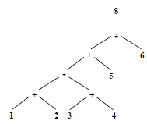
Example
To calculate the arithmetic expression of the following tree
It can be written as *+*+1 2+3 4 5 6
The above arithmetic expression in (o-o-o) form can be calculated as
*+*+1 2+3 4 5 6 = *+*3+3 4 5 6
= *+*3 7 5 6 = *+21 5 6 = *26 6 = 156.

Slide 28
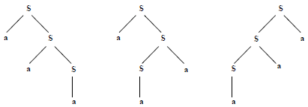
Ambiguous CFG
Example: Consider the following CFG
S aS|Sa|a
The word aaa can be generated by the following three different trees

Slide 29
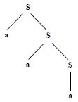
Thus the above CFG is ambiguous, while the CFG, S aS|a is not ambiguous as neither the word aaa nor any other word can be derived from more than one production trees. The derivation tree for aaa is as follows

Slide 30
LINK
en.wikipedia.org/wiki/Pumping_lemma_for_regular_languages
www.seas.harvard.edu/courses/cs121/notes/07-Pump.pdf

